Slide 1
Generalised Verification for Quantified Permissions
Initial Presentation of Master Thesis Project
Nadja Müller
Supervisor: Alex Summers

Slide 2
Viper: Unbounded Heap Structures
Predicates
Magic Wands
Quantified Permissions

Slide 3

Quantified Permissions
Current Structure:
$$forall x:T ∷c\left(x\right)⇒acc\left(e\left(x\right).f, p\left(x\right)\right)$$
c(x): boolean expression
e(x): injective, reference-typed expression
p(x): permission expression

Slide 4
Core Goals
Design & Implementation (Carbon & Silicon):
combinations of quantified pure and permission-based assertions
predicate support within quantified permissions
Design:
magic wand support within quantified permissions
nested quantified permissions

Slide 5
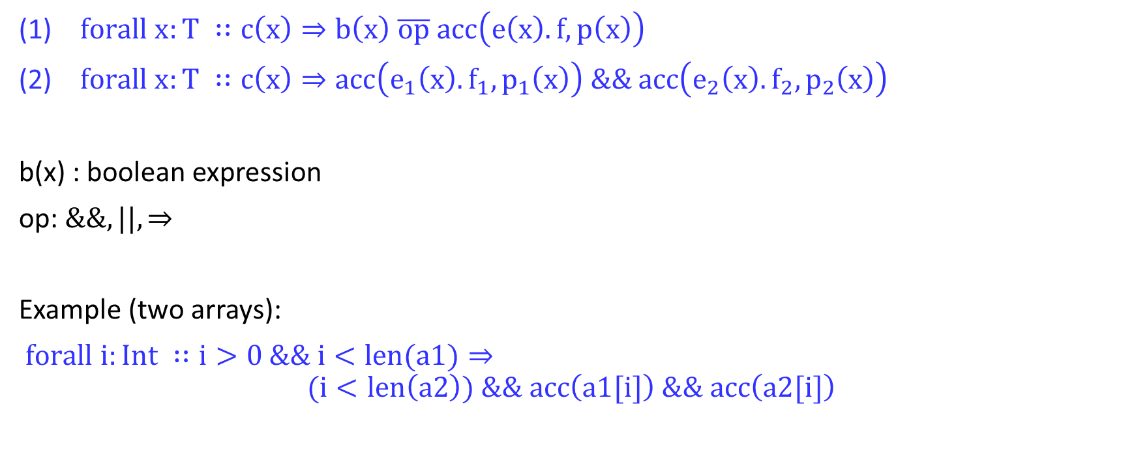
Combinations with pure Quantifiers and Quantified Permissions
$forall x:T ∷c\left(x\right)⇒b\left(x\right) \overline{op} acc\left(e\left(x\right).f, p\left(x\right)\right)$
$forall x:T ∷c\left(x\right)⇒acc\left(e_{1}\left(x\right).f_{1}, p_{1}\left(x\right)\right) \&\& acc\left(e_{2}\left(x\right).f_{2}, p_{2}\left(x\right)\right)$
b(x) : boolean expression
op: $\&\&, ||, ⇒$
Example (two arrays):
$forall i:Int ∷i>0 \&\& i<len(a1)⇒$
$$(i<len\left(a2\right)) \&\& acc\left(a1[i]\right) \&\& acc\left(a2[i]\right)$$

Slide 6
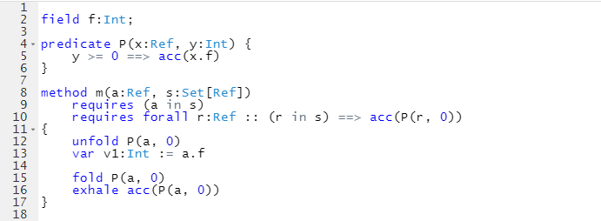
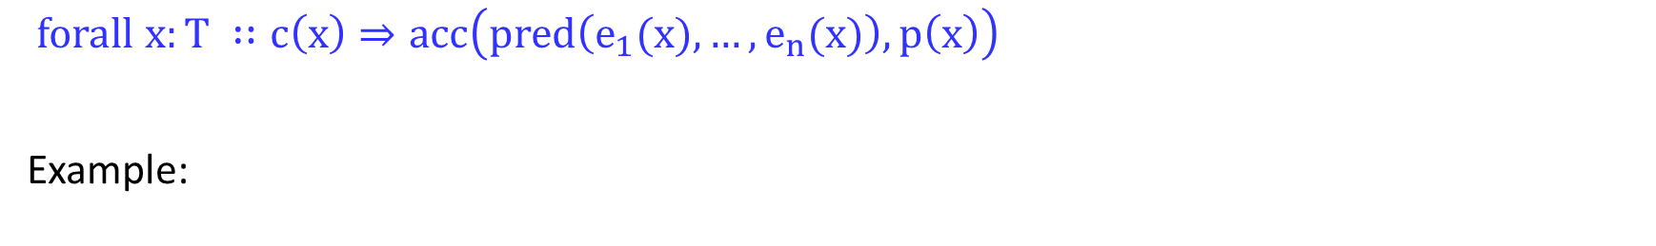
Predicates
$forall x:T ∷c\left(x\right)⇒acc\left(pred\left(e_{1}(x),…,e_{n}(x)\right), p\left(x\right)\right)$
Example:

Slide 7
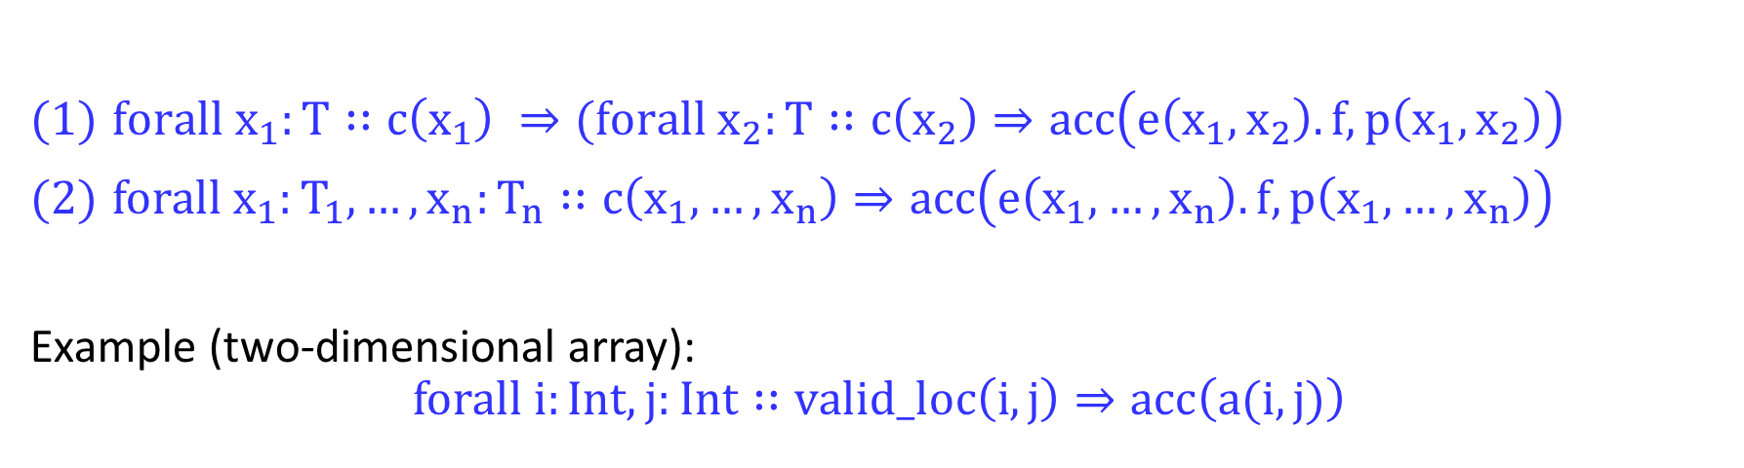
Magic Wands
might depend on x
$$forall x:T ∷c\left(x\right)⇒(A −−∗B)$$
Nested Quantified Permissions
$forall{ x}_{1}:T∷c\left(x_{1}\right) ⇒(forall{ x}_{2}:T∷c\left(x_{2}\right)⇒acc\left(e\left(x_{1},x_{2}\right).f, p\left(x_{1},x_{2}\right)\right)$
$forall x_{1}:T_{1},…,x_{n}:T_{n}∷c\left(x_{1}, …,x_{n}\right)⇒acc\left(e\left(x_{1}, …,x_{n}\right).f, p\left(x_{1}, …,x_{n}\right)\right)$
Example (two-dimensional array):
$$forall i:Int, j:Int∷valid_loc\left(i, j\right)⇒acc\left(a(i, j)\right)$$

Slide 8
Extensions
Implementation in Carbon and/or Silicon:
magic wand support within quantified permissions
nested quantified permissions

Slide 9
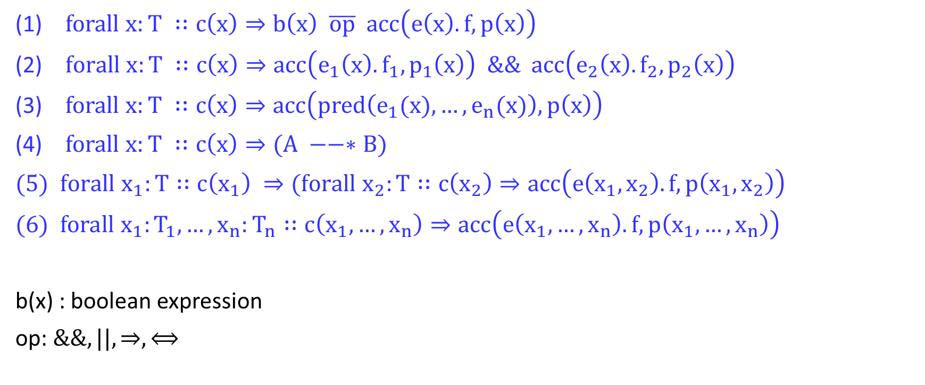
Overview
$forall x:T ∷c\left(x\right)⇒b\left(x\right) \overline{op} acc\left(e\left(x\right).f, p\left(x\right)\right)$
$forall x:T ∷c\left(x\right)⇒acc\left(e_{1}\left(x\right).f_{1}, p_{1}\left(x\right)\right) \&\& acc\left(e_{2}\left(x\right).f_{2}, p_{2}\left(x\right)\right)$
$forall x:T ∷c\left(x\right)⇒acc\left(pred\left(e_{1}(x),…,e_{n}(x)\right), p\left(x\right)\right)$
$forall x:T ∷c\left(x\right)⇒(A −−∗B)$
$forall{ x}_{1}:T∷c\left(x_{1}\right) ⇒(forall{ x}_{2}:T∷c\left(x_{2}\right)⇒acc\left(e\left(x_{1},x_{2}\right).f, p\left(x_{1},x_{2}\right)\right)$
$forall x_{1}:T_{1},…,x_{n}:T_{n}∷c\left(x_{1}, …,x_{n}\right)⇒acc\left(e\left(x_{1}, …,x_{n}\right).f, p\left(x_{1}, …,x_{n}\right)\right)$
b(x) : boolean expression
op: $\&\&, ||, ⇒, ⟺$

